Slide 1

Frantz Fanon
Black Consciousness and Black Phenomenology
GENTRAIN
MONTEREY PENINSULA COLLEGE
STEPHANIE SPOTO

Slide 2
Phenomenology
Phenomenology: the science of phenomena as distinct from that of the nature of being
  An approach that concentrates on the study of consciousness and the objects of direct experience.
Edmund Husserl, the Father of Phenomenology
  Phenomenology is interested with focused and systematic consideration of the structures of consciousness → phenomena that appear in acts of consciousness
  ‘phenomena’: from Greek, thing appearing to view.
  Kant contrasted phenomena with noumena, which cannot be directly viewed
Some assumptions of phenomenology:
  Reject concept of objectivity or objective research
  Analyzing daily human behavior can help us understand nature
  Persons should be explored → they reflect the society they live in
  Gather “capta” or conscious experience, rather than traditional data
  Oriented towards discovery → use methods less restrictive than (other) sciences

Slide 3
W.E.B. Du Bois and Steve Biko
Black Phenomenology
Many point to Du Bois as the 20th century’s first black phenomenologist
Double consciousness is Du Bois’s analysis of subjectivity → culturally situated conceptions of self and of other
Starts with a question: “How does it feel to be a problem?”
  To answer this question, Du Bois develops a phenomenology of black subjectivity → how black people experience the world and themselves
Steve Biko (1946-1977): South African anti-apartheid activist and philosopher
  South Africa divided into “whites” and “non-whites” → Biko saw latter category as a negative category

Slide 4
Steve Biko on Black Consciousness
Black consciousness directs himself to the black man and to his situation, and the black man is subjected to two forces in this country. He is first of all oppressed by an external world through institutionalized machinery and through laws that restrict him from doing certain things, through heavy work conditions, through poor pay, through difficult living conditions, through poor education, these are all external to him. Secondly, and this we regard as the most important, the black man in himself has developed a certain state of alienation, he rejects himself precisely because he attaches the meaning white to all that is good, in other words he equates good with white. This arises out of his living and it arises out of his development from childhood.
-Steve Biko
Black consciousness is “an attitude of mind, a way of life. The basic tenet of black consciousness is that the Blackman must reject all value systems that seek to make him a foreigner in the country of his birth and reduce his basic human dignity”.
Beaten to death by police at Warlmer Police Station in Port Elizabeth 6 September 1977.

Slide 5
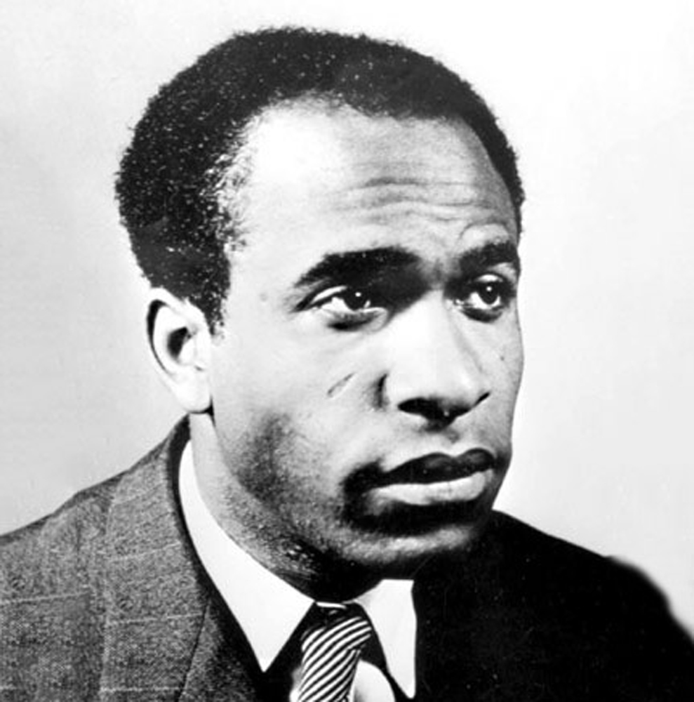
Frantz Fanon
(1925-1961)
Born in Martinique (French colony)
One of the most important Black philosophers in the 20th century→ esp. in the era of anti-colonial theory and struggle
  His influence in the Global south has been considerate and long-lasting
Diverse in his influences → takes elements from psychology, philosophy, poetry, etc.
His two most important works:
  Black Skin, White Masks (1952)
  Wretched of the Earth (1961)
Two collections of essays:
  A Dying Colonialism (1959)
  Toward the African Revolution (1964) – posthumously published
  Écrits sur l’aliénation et la liberté (2015)
Moved from the Caribbean to Europe to North African to Sub-Saharan Africa → each move transforming his thought
Diagnosed with leukemia, and as moved by the CIA to a hospital in Maryland where he died in 1961.

Slide 6
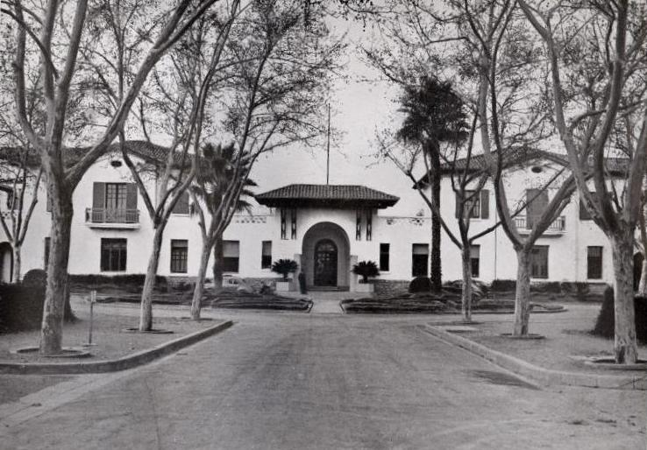
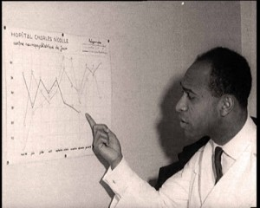
Psychiatry and the Algerian struggle
Fanon’s theory and philosophy grappled with some fundamental and important trending thoughts of his day
  Sexuality and gender, race and racism, social formation, philosophy of time, language, religion, and others.
Moved to Algeria in 1953, and had an immediate impact
  Appointed as psychiatrist in Blida-Joinville Hospital
Began to participate in the Algerian independence movements → influenced his thinking.
  Shifted from focus on theories of blackness (Black Skin, White Masks) to a more expansive and more ambitious theory of colonialism (Wretched of the Earth).
  Theorized a postcolonial future
Wanted his writings to get to as many people as possible, to translate his radical theories for all audiences → wrote for both academic journals, popular magazines, and revolutionary newspapers
  Worked as an academic, revolutionary with the Algeria National Liberation Front (FLN), was the Ambassador to Ghana, and was a conference participant at several radical meetings across Africa.
Blida-Joinville Hospital, 1933

Slide 7
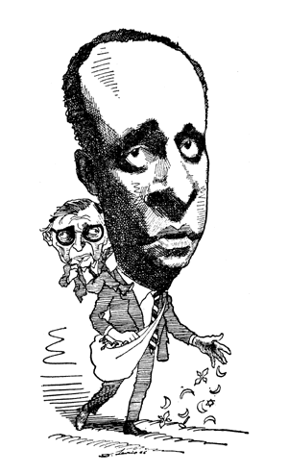
Review – Hegel’s Master-Slave Dialectic and Sartre’s ‘Look’
Hegel: The Master and the Slave are locked in a relationship
  Consciousness of the self emerges in an encounter between two distinct self-conscious beings. This leads to a struggle, where one dominates the other.
  The lordship and domination over the other makes recognition of humanity impossible, since the slave is not free to offer that recognition.
Sartre, “The Look”: A central concept in Sartre’s work.
  A consciousness is conscious of Others
  Is forced to recognize that it exists not only in itself gazing outwards, but is also mere object for the Other’s consciousness
  Look affirms selfness and humanity because the Other also recognizes us as a conscious being with subjectivity.

Slide 8
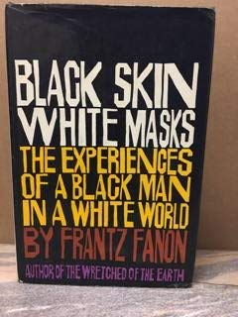

“The Lived Experience of Blackness”
Black Skin, White Masks
Black Skin, White Masks is one of Fanon’s most important works
“The Lived Experience of Blackness”
  Works to challenge and eventually debunk myths and legacies of racial essentialism → the idea that there are characteristics (either positive, negative, or neutral) that are inherent to black people by virtue of their so-called race
  A response to Aimé Césaire and the Négritude movement, which argued that it was important to relate to and raise up a “black consciousness”
Phenomenological and Existential: starts with a real experience, the white child pointing at Fanon on the train and shouting, “Look, a Negro!” (a phrase that he says is a racial slur – racism is central to the declaration rather than just being an addendum at the end)
On Sartre: Fanon returns to Sartre’s account of the ‘look’ or the ‘gaze’ and how it fixes the Other → but injects this account of Sartre’s gaze with a subtle treatment of structures of an anti-black world.
  The white gaze (and the white imaginary) constructs and fixes blackness → sealing blackness into itself (as a slur and as part of the corporeal/epidermal schema)
Notes:
Fanon also explores Sartre’s own account of anti-Semitism → claim that it doesn’t match up to the phenomenon of anti-Blackness as a form of racism.
The anti-Semite dislikes and fears the Jewish person because of the Jewish person’s supposed power and higher capacity. However, the anti-Black racist dislikes the black person because of the supposed weakness and incapacity which is supposed to accompany blackness.
Anti-Semitism reveals a panic and fear about Jewish superiority, but anti-black racism reveals contempt for black inferiority

Slide 9

An Object among Objects – the experience of the black man
“Dirty N----r!” or simply, “Look, a Negro!”
“I came into the world imbued with the will to find a meaning in things, my spirit filled with the desire to attain to the source of the world, and then I found that I was an object in the midst of other objects.”
“Crushed into crushing objecthood, I turned beseechingly to others. Their attention was a liberation, running over my body suddenly abraded into non-being, endowing me once more with an agility that I had thought lost, and by taking me out of the world, restoring me to it. But just as I reached the other side, I stumbled, and the movements, the attitudes, the glances of the other fixed me there, in the sense in which a chemical solution is fixed by a dye.”

Slide 10
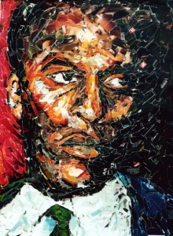
Racial schema
“And then occasion arose when I had to meet the white man’s eyes. An unfamiliar weight burdened me. The real world challenged my claims. In the white world the man of color encounters difficulties in the development of his bodily schema. Consciousness of the body is solely a negating activity. It is a third-person consciousness.”
“Below the corporeal schema I had sketched a historico-racial schema. The elements that I used had been provided for me not by ‘residual sensations and perceptions primarily of a tactile, vestibular, kinesthetic, and visual character’, but by the other, the white man, who had woven me out of a thousand details, anecdotes, stories.”

Slide 11
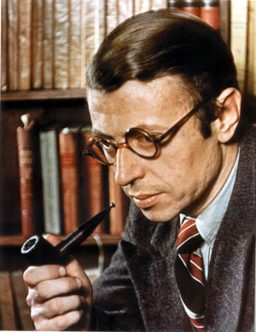
Responding to Sartre
“Without a Negro past, without a Negro future, it was impossible for me to live my Negrohood. Not yet white, no longer wholly black, I was damned. Jean-Paul Sartre had forgotten that the Negro suffers in his body quite differently from the white man. “
Footnote: “Though Sartre’s speculations on the existence of The Other may be correct (to the extent, we must remember, to which Being and Nothingness describes an alienated consciousness), their application to a black consciousness proves fallacious. That is because the white man is not only The Other but also the master, whether real or imaginary”.

Slide 12
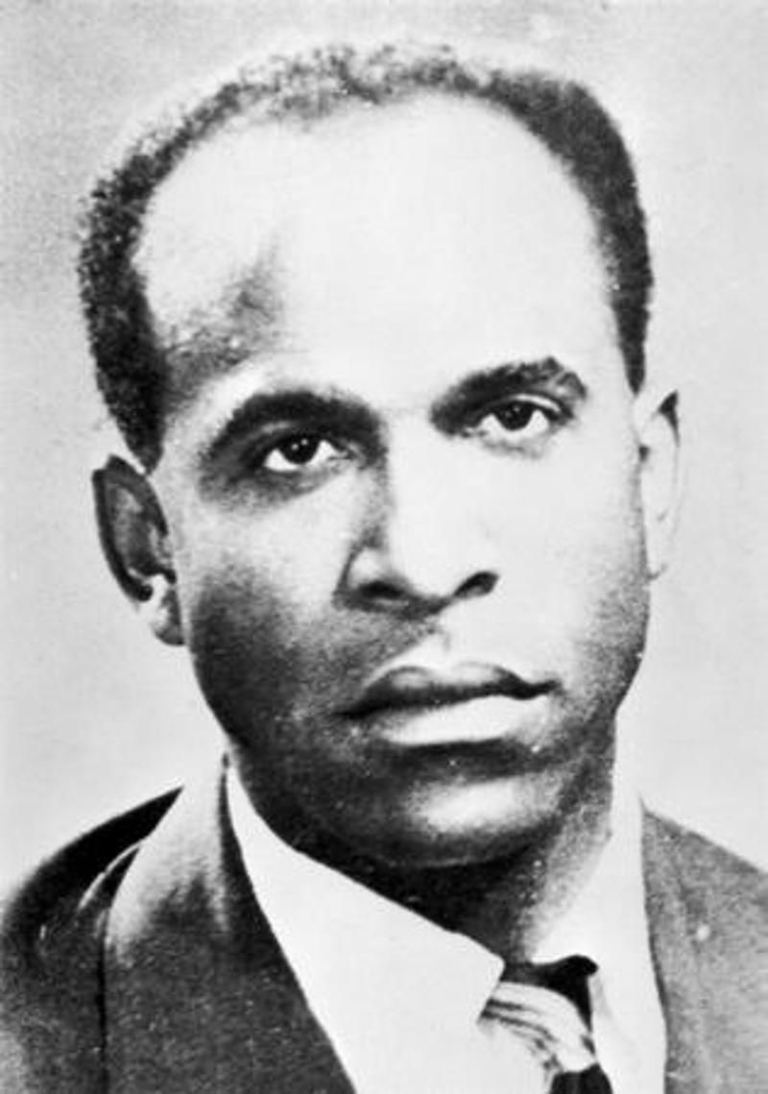
Crippled by the White Gaze
“The crippled veteran of the Pacific war says to my brother, ‘Resign yourself to your color the way I got used to my stump; we’re both victims’”
“Nevertheless, with all my strength I refuse to accept that amputation. I feel in myself a soul as immense as the world, truly a soul as deep as the deepest of rivers, my chest has the power to expand without limit. I am a master and I am advised to adopt the humility of the cripple. Yesterday, awakening to the world, I saw the sky turn upon itself utterly and wholly. I wanted to rise, but the disemboweled silence fell back upon me, its wings paralyzed. Without responsibility, straddling Nothingness and Infinity, I began to weep.”

Slide 13

“On National Culture”
Wretched of the Earth
Paradox in the formation of national identity → important for setting up anti-colonial struggle, but it limits liberation
  Reinscribes “African culture” with essentialist and bourgeois concepts → must break beyond the colonial-colonized dialectic
Hegemonic concept of “nation” actually re-inscribes racist colonial discourses
  Native fight colonial brutality on “the field of the whole continent” → no cultural differences between Africans
  Alignment happens unconsciously: “on the unconscious plane”
  colonialism does not find contentment in mere the mere domination of land, but must also hold “a people in its grip” by “emptying the native’s brain of all form and content” and by destroying or distorting the colonized subject’s access to the past – a destruction which takes on “a dialectical significance today” .
Chapter explores difference between “nation” and “culture” → notices people seeking liberation through homogenous black culture rather than specific national culture/literature
Colonialism destroyed culture then filled the gaps by white culture → difficult to find authenticity.
  The Native’s own worldview is filtered through the white imaginary: “At the very moment when the native intellectual is anxiously trying to create a cultural work he fails to realize that he is utilizing techniques and language which are borrowed from the stranger in his country” (223).

Slide 14
No liberation in colonial or “pre-colonial” culture
African Cultural Society → set up to counter the European Cultural Society (imagined itself universal)
  The African Cultural Society imagines that such a thing as “African” culture exists and works by “opposing their ideas to those of ostentatious and narcissistic Europeans” → in relationship with colonizer
African Cultural Society in 1956 in Paris, during which black Americans “of their own accord considered their problems from the same standpoint as those of their African brothers” (215).
  “Negroes of Chicago only resemble Nigerians or the Tanganyikans in so far as they were all defined in relation to whites”
Keita Fobeda “African Dawn” and Tayeb Salih Seasons of Migration to the North (1967)
  Joseph Campbell’s Monomyth/Hero’s Journey……Europe is hell…return is not rebirth
Rather than seeking liberation through the construction of culture, Fanon sees “you do not show proof of your nation from its culture but that you substantiate its existence in the fight which the people wage against the forces of occupation” (223). To fight for a culture means that heroes must fight “for the liberation of the nation, that material keystone which makes the building of a culture possible” (233). Neither in the false constructed homogenous “African” history nor in the stories of the colonizers will colonized peoples find their true culture and humanity, but only in struggle.

Slide 15
Sources & Resources
Frantz Fanon, “The Fact of Blackness”, Black Skin, White Masks: https://monoskop.org/images/a/a5/Fanon_Frantz_Black_Skin_White_Masks_1986.pdf?fbclid=IwAR1gneQzTkjL1WS9CJhLCmEGGnH-25OTbZihJMfyVQuDjdKyYwcU3gTeIe8
Jean-Paul Sartre, “Preface,” Wretched of the Earth: https://www.marxists.org/reference/archive/sartre/1961/preface.htm
Achille Mbembe, lecture on Frantz Fanon: https://www.youtube.com/watch?v=lg_BEodNaEA

